Slide 1
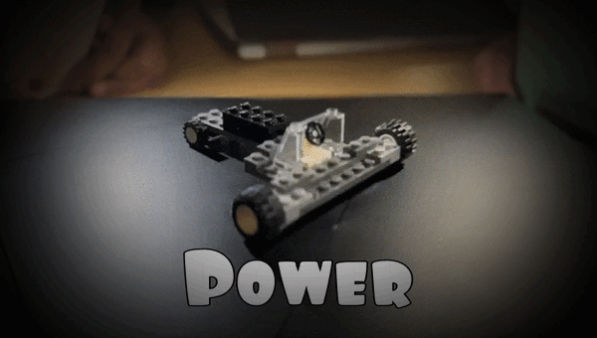
Lego DOE Presentation
Team 101
Notes:
Sashwat

Slide 2
Objectives / Goals
Optimize Performance
Harness the Power of Data
Cost-Savvy Engineering
Real-World Skill-Building
Notes:
Sashwat

Slide 3
Experiment
Setup:
Created multiple car designs using available materials to drive down a ramp at a consistent 30-degree angle.
Designed a Lego cars with team collaboration following project constraints (e.g., windshield and steering wheel required).
Measurements Taken:
Response Variable: Distance traveled by the car.
Conducted multiple trials for each car design and size to ensure data consistency.
Ramp Setup Challenges
Material Stability
Angle Consistency
Reproducibility: Maintaining the exact same starting height and ramp length for each trial required careful adjustments and monitoring.
Notes:
Saranya

Slide 4
Ramp for Experiment
12 cm
24 cm
30°
Notes:
Saranya

Slide 5
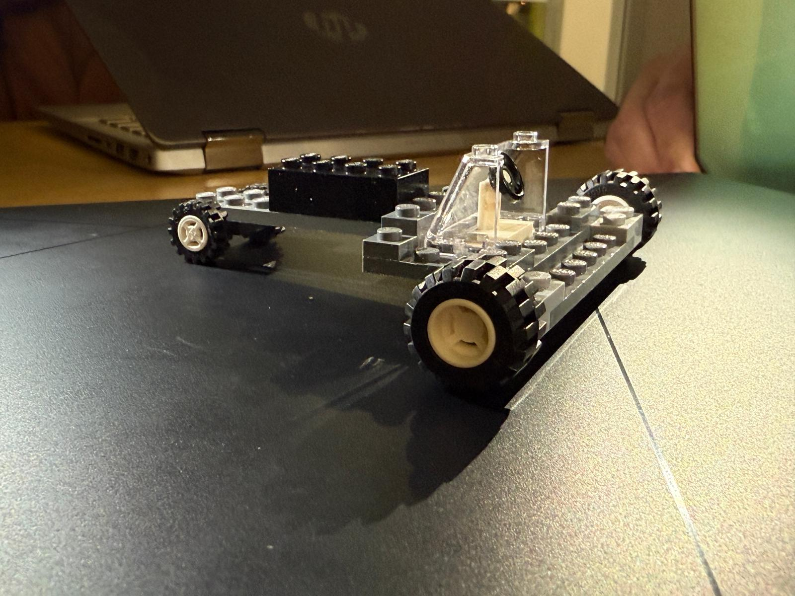
Factors
Car Size
Car Style
Car Price
Notes:
Jean

Slide 6
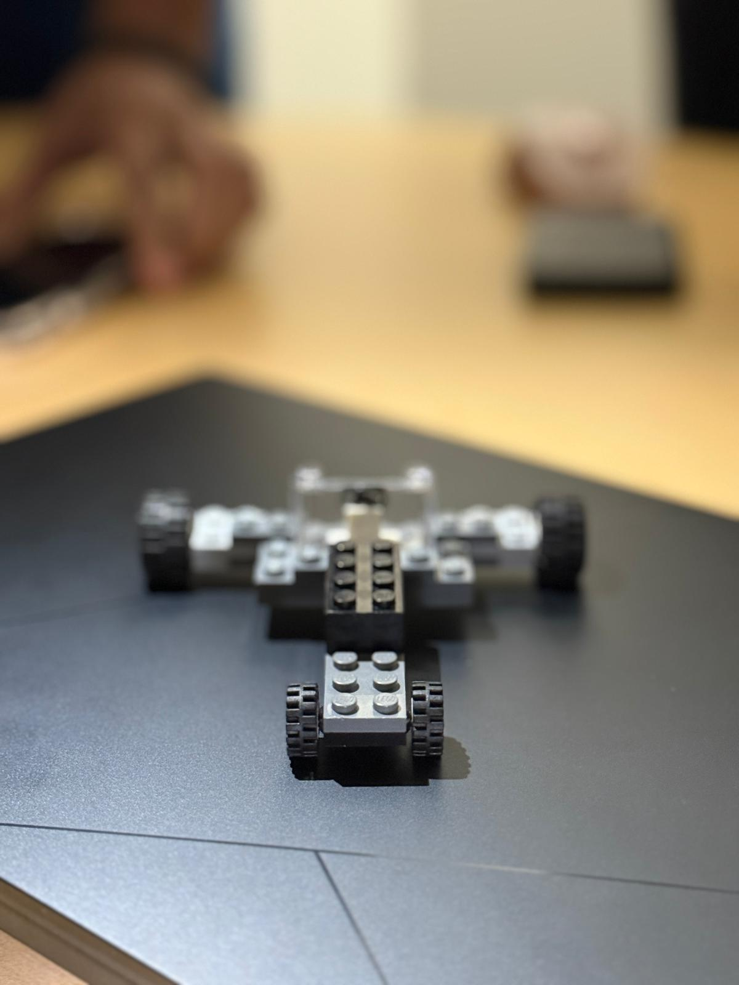
Response Variables
Time (s)
Final Distance (cm)
Speed (cm/s)
Notes:
Jean

Slide 7
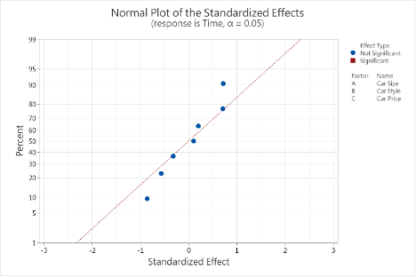
Graph (Time)
Notes:
Kyle

Slide 8
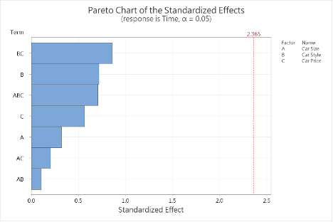
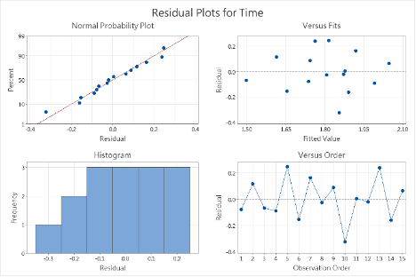
Graph (Time)
Notes:
Kyle

Slide 9
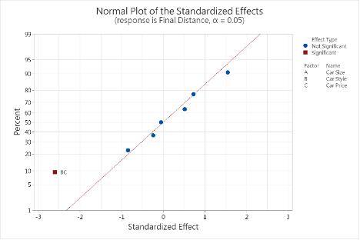
Graph (Final Distance)
Notes:
Kyle

Slide 10
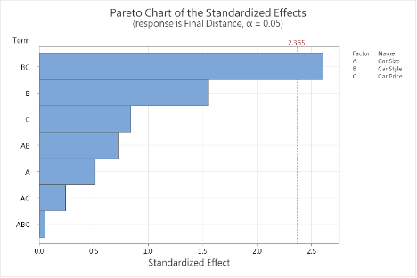
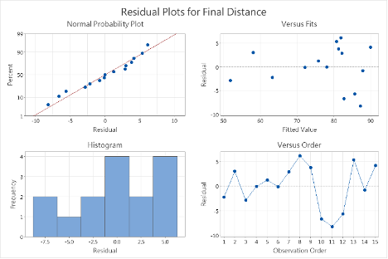
Graph (Final Distance)
Notes:
Kyle

Slide 11
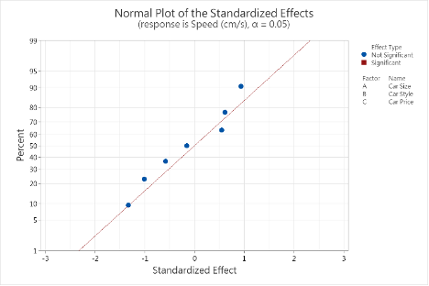
Graph (Speed)
Notes:
Kyle

Slide 12
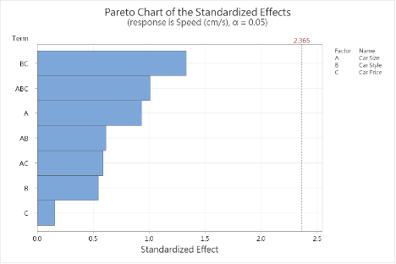
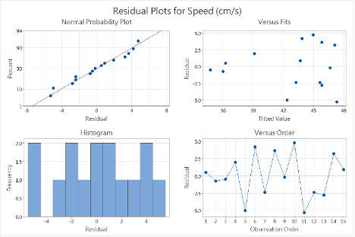
Graph (Speed)
Notes:
Kyle

Slide 13
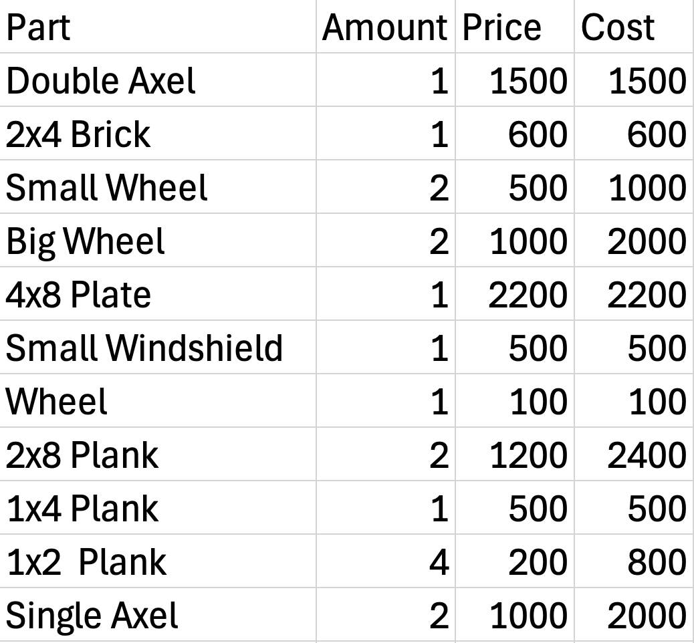
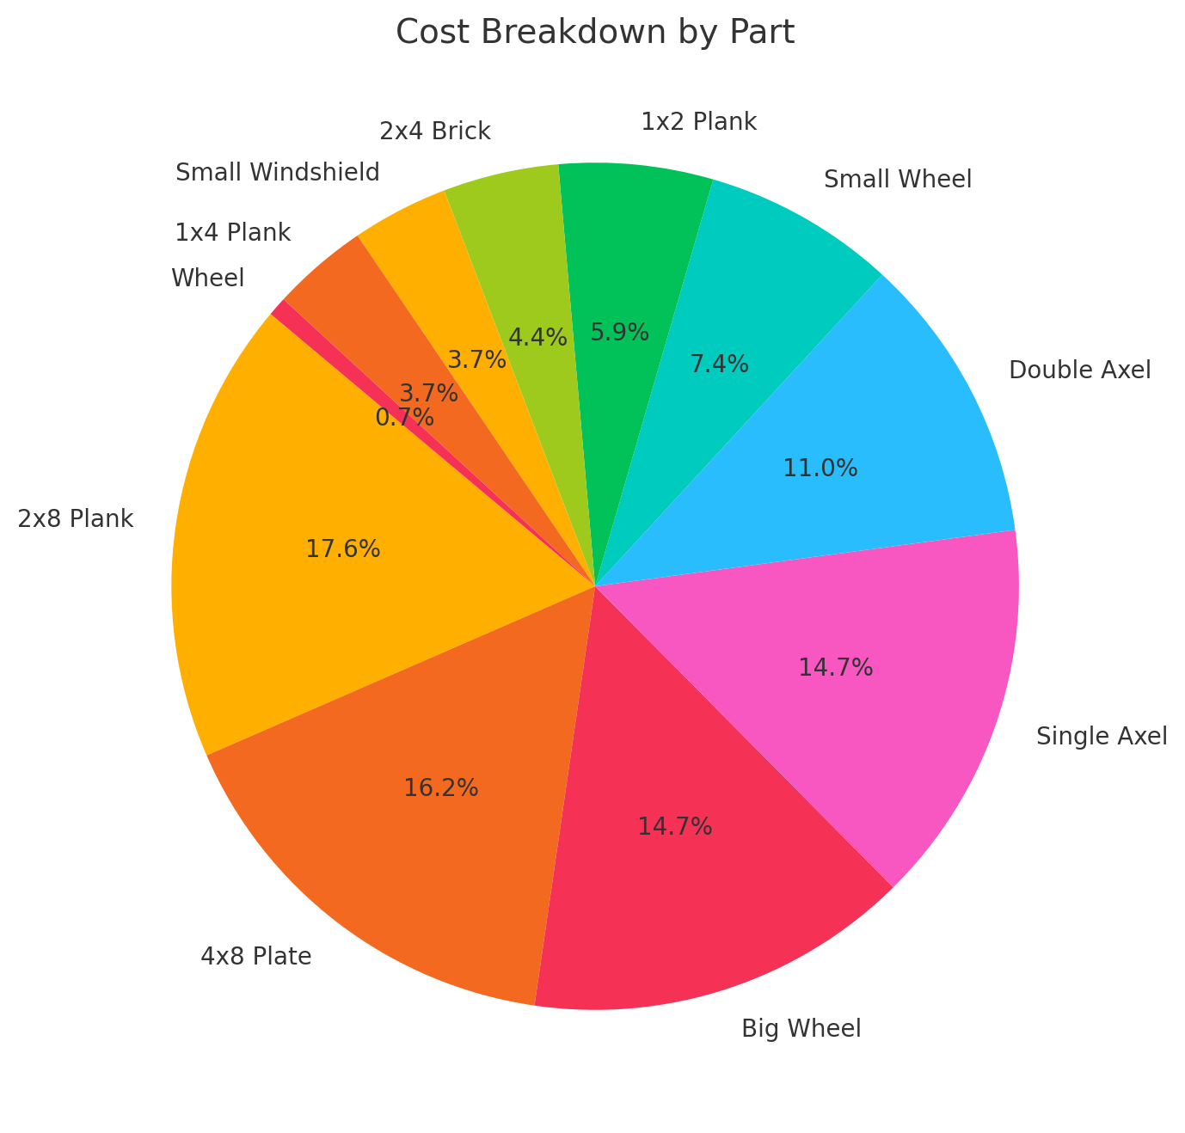
Financial Analysis of the Most Efficient Lego Car
Total Cost = 13600
While Maybe more expensive than most, it provides state of the art design to keep it from falling apart.
We could cut down on the cost by removing the 1x2 Planks and one of the Small Wheels.
Notes:
Nived

Slide 14
Thank you
Notes:
Nived

